Slide 1
MRS C GREN
M = movement
R = respiration
S = sensitivity
C = control (homeostasis)
G = growth
R = reproduction
E = Excretion
N = nutrients
What is homeostasis?
What are the 2 forms of reproduction
What is the definition of evolution?
What 2 organelles does a plant cell have that an animal does not?

Slide 2
SWBAT define cellular respiration and state its importance for survival
TRACK WITH ME
READ WITH ME
I can name the products of cellular respiration
I can name why respiration is important
I can describe the link between respiration and photosynthesis

Slide 3
MAKE THE CONNECTION
This is the Respiration part of the MRS C GREN
Respiration is how we consume energy

Slide 4
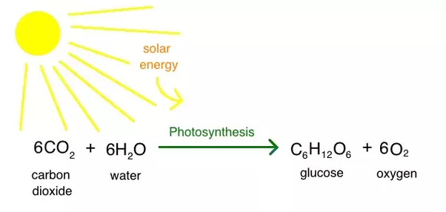
MAKE THE CONNECTION
Photosynthesis is the conversion of sunlight to energy
Cellular respiration is the
next step that follows

Slide 5
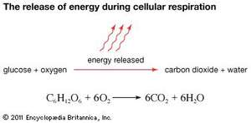
TEACHER CUE
CFU
In cellular respiration a glucose molecule is broken down into carbon dioxide and water

Slide 6
Energy produced
ATP is made
Molecule that contains energy
Adenosine triphosphate

Slide 7
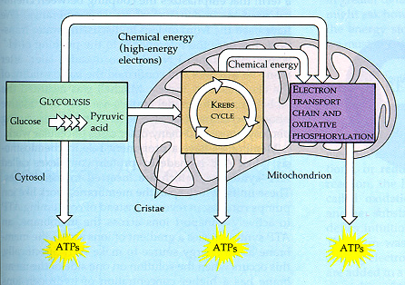
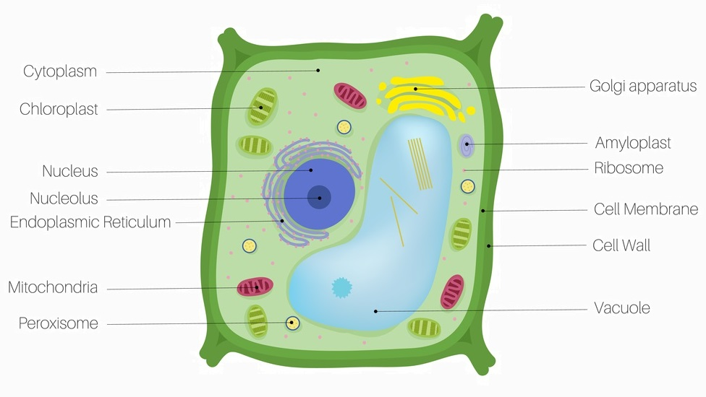
Occurs partially in the mitochondria and partially in the cytoplasm

Slide 8
So why is cellular respiration important?
Cellular respiration converts glucose (sugar) into energy
Energy is needed to perform all functions in life

Slide 9
SWBAT define cellular respiration and state its importance for survival
TRACK WITH ME
READ WITH ME
I can name the products of cellular respiration
I can name why respiration is important
I can describe the link between respiration and photosynthesis

Slide 10
SWBAT recall the levels of organisation in the body
TRACK WITH ME
READ WITH ME
I can describe the link between cells ➔ tissues ➔ organs and systems
I can name examples of different types of organ systems

Slide 11
Tomorrow we move on to systems in the body
We need to understand how cells contribute to systems

Slide 12
TRACK WITH ME
READ WITH ME
Cells are the smallest block of life
Cells transform sunlight to sugar
Cells transform sugar into energy

Slide 13
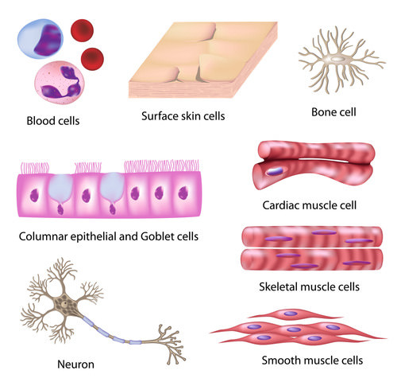
Cells are the first step

Slide 14
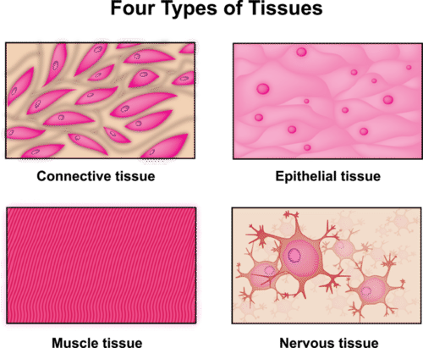
Tissues
Group of connected cells that have similar functions
Four types

Slide 15
Organs
An organ is a structure that consists of two or more types of tissues that work together to do the same job
Can you think of an example of an organ?

Slide 16
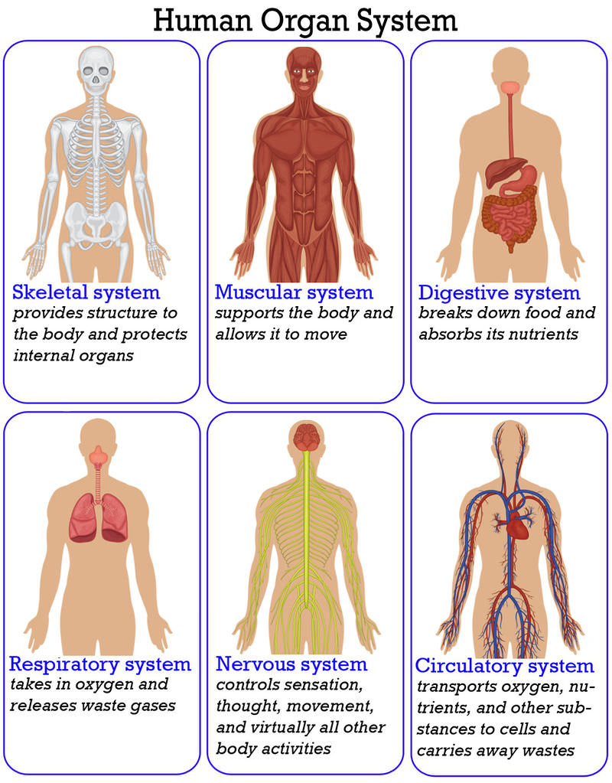

Slide 17
TEACHER CUE
CFU
Can you draw a flow chart with examples of the levels of organisation in your book
HINT
Scaffolding for students
Notes:
Please include tasks/questions here rather than just referring to a worksheet. This will save on photocopying and facilitate sharing with other schools.
Try and build tasks/questions which escalate through Bloom’s Taxonomy. This will help with differentiation.

Slide 18
SWBAT recall the levels of organisation in the body
TRACK WITH ME
READ WITH ME
I can describe the link between cells ➔ tissues ➔ organs and systems
I can name examples of different types of organ systems

